Slide 1
The First step Exploratory Data Analysis
Alejandro Ordonez
Assistant Professor - Department of Bioscience
Section for Ecoinformatics & Biodiversity
Center for Biodiversity Dynamics in a Changing World (BIOCHANGE)

Slide 2
Exploratory Data Analysis What we will talk about today
A very quick recap on R basics
Exploratory Data Analysis - Why?
Summary statistics – Get an overview of your data
Visualisation – A figure is worth 1000 words
Transformations – Making data symmetrical an comparable
Modelling – Establish simple relations between variables
Statistical Test – What are they doing?

Slide 3
Any questions?
Ready to start?

Slide 4
an introduction to R
What is R?
R is an…
object-oriented statistical programming language.
Object-oriented programming is a programming model organised around objects rather than "actions" and data rather than logic.
A programming language is a vocabulary and set of rules for instructing a computer to perform specific tasks.

Slide 5
The R way of doing things structure – functions/methods
R focuses on three types of elements
Functions/Methods: what do you want to do?
Control elements: when/how you want to do something?
Objects: on what do you want to use a function?
Object
Function
Object
Control elements

Slide 6
The R way of doing things structure – functions/methods
Function/Method
Argument
Object
sqrt(x = 16)
How this looks in R
sqrt(x = 16)
[1] 4
out = sqrt(x = 16)
out
[1] 4

Slide 7
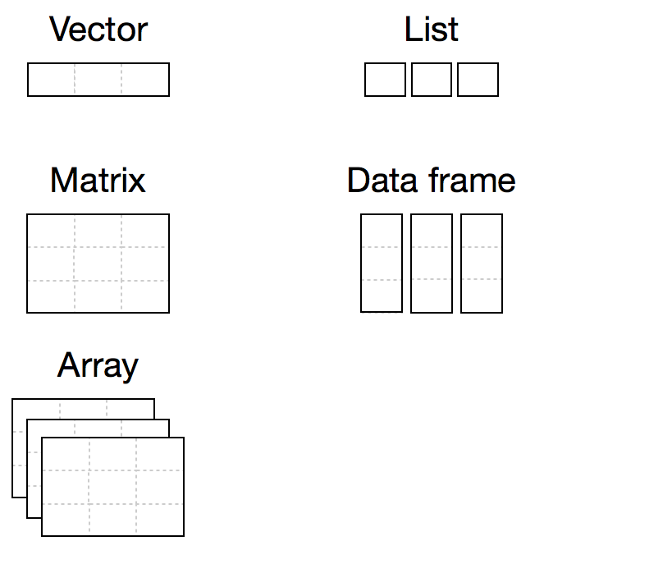
The R way of doing things structure – Objects
List <- list(id = c (1:5),
name = c(”R","D","M","R", "G"),
salary = c(62, 51, 61, 72, 84))
a = c(4,2,5,10)
The most useful as it stores information as tabular data and collates different information types into one object.
A = matrix(data = 0,
nrow = 6,
ncol = 5)
Data <- data.frame(id = c (1:5),
name = c(”R","D","M","R", "G"),
salary = c(62, 51, 61, 72, 84))
Grolemund (2014) Hands-On Programming with R

Slide 8
The R way of doing things Reading an saving information
The generic Function [Generally you need to specify ALL arguments]
read.table() ➔ generic function to read tables
write.table () ➔ generic function to save a table
The one you will use most [Often you need one specify file name]
read.csv() ➔ reading coma separated files
myData = read.csv(“some data.csv”)
write.csv() ➔ saving coma separated files
myData = read.csv(x = myData,
file = ”updated data.csv”)

Slide 9
The R way of doing things Packages
What are Packages?
Packages are collections of functions that have a specific function.
You need to install these and call these before you can use them → only once
Many packages depend on other packages – dependencies
install.packages()
require(package.name)
Installing packages via the console

Slide 10
So far so good?
Any questions?
Ready to continue?

Slide 11
Exploratory Data Analysis: why?
Exploratory Data Analysis (EDA) is the art of looking at your data to rapidly generate many promising leads that you can later explore in more depth.
EDA is the base for statistical analysis of multidimensional data by:
Provide an overview of the data → is it meaningful?
Establish if there are errors, outliers, or patterns.
Help to determine the need to transform or recode some variables → are the analytical assumptions meet?
Orient further analyses.

Slide 12
Before Exploratory Data Analysis: get your data in.
Before doing anything in R you need to get your data in the program.
External data is usually a txt or csv file that needs to be “read” using one of two functions.
read.table?
read.csv?
Reading is not enough, It needs to be stored it as an object!!
Import
Analyze
Visualize
Clean
Transform
Explore
Model

Slide 13
Before Exploratory Data Analysis: Clean your data
Import
Analyze
Visualize
There are three interrelated rules which make a dataset suited to be used in R:
Each variable must have its own column.
Each observation must have its own row.
Each value must have its own cell.
Clean
Transform
Explore
Model
Figures: Grolemund and Wickham (2017) R for Data Science

Slide 14
Before Exploratory Data Analysis: Clean your data.
Step 1. Remove
Leading/Trailing spaces.
Comma, dots, hyphens and apostrophes.
Spaces and Multiple spaces.
Step 2. Standardise
To lowercase/uppercase Or
Capitalise.
Put/remove a dots at the end and punctuation.
Change “,” to “;” in the text.
Date formats.
Precision [Nº of decimals]
Step 3. Error checking
Correcting or removing corrupt or inaccurate records.
Eliminate duplicate entries.
Data type consistency within a column.
Figures: Grolemund and Wickham (2017) R for Data Science

Slide 15
Exploratory Data Analysis What to do before you start?
The two crucial questions you will always ask:
What type of variation occurs within my variables?
Variation is a description of how a random variable is dispersed, or spread out.
What type of covariation occurs between my variables?
Covariation is a description of the relationship between two random variables
Import
Analyze
Visualize
Clean
Transform
Explore
Model

Slide 16
Exploratory Data Analysis: tools
EDA uses four main tools to answer the two key questions:
Descriptive statistics: Quantitative descriptions or summaries of the features from a collection of information.
Visualisation: The graphical representation of information and data to see and understand trends, outliers, and patterns.
Transformation: process of changing the format, structure, or values of data.
Modelling: simple low-dimensional summaries of a dataset, and trends assessments.

Slide 17
Exploratory Data Analysis: tools
Descriptive
statistics
Visualisation
Transformation
Modelling
Figures: Grolemund and Wickham (2017) R for Data Science

Slide 18
Exploratory Data Analysis: tools
Descriptive
statistics
Visualisation
Transformation
Modelling
Figures: Grolemund and Wickham (2017) R for Data Science

Slide 19
EDA – Descriptive statistics
Summaries provide a good way to:
Look at patterns and the quality of your data.
Communicate the largest amount of information as simply as possible.
All your observations regarding a single variable can be described in terms of:
Central tendency (mean, median, mode).
Dispersion (variance, standard deviation, coefficient of variation).
Shape of the distribution (skewness, kurtosis).
Statistical dependence (correlation coefficients).

Slide 20

EDA – Descriptive statistics
Central tendency
Characterises the central point of the observations
Mean
Median
Mode
$σ^{2}=$ Variance
$σ=$ Standard Deviation
$\frac{σ}{\sqrt{n}}=$Standard Error
$$σ^{2}=\sqrt{\frac{\sum{{\left(x_{i}−μ\right)}^{2}}}{N}}$$
Dispersion
Characterises the variability of the observations

Slide 21

EDA – Descriptive statistics
Shape
Characterize the deviation from a normal (symmetrical) distribution
Skewness
$${Sk}_{1}=\frac{μ−Mo}{σ^{2}}$$
$${Sk}_{2}=\frac{3\left(μ−Md\right)}{σ^{2}}$$
Skewness direction given by the sign
μ < Md or Mo
μ > Md or Mo

Slide 22
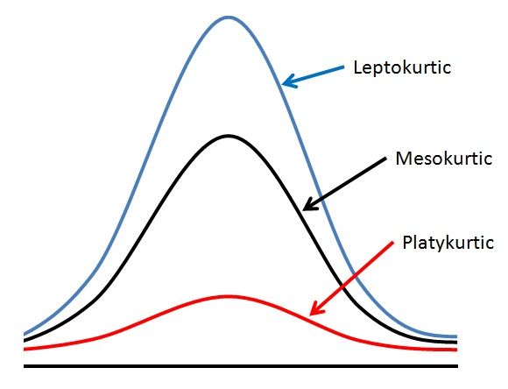


EDA – Descriptive statistics
Shape
Help to identify outlier problems.
$$g_{2}=\frac{m_{4}}{m_{4}}−3$$
$=\frac{\frac{1}{n\sum_{i=1}^{n}{{\left(x_{i}−\overline{x}\right)}^{4}}}}{{\left[n\sum_{i=1}^{n}{{\left(x_{i}−\overline{x}\right)}^{4}}\right]}^{2}}−3$
Kurtosis
Larger kurtosis = serious outlier problem

Slide 23
Exploratory Data Analysis: tools
Descriptive
statistics
Visualisation
Transformation
Modelling
Figures: Grolemund and Wickham (2017) R for Data Science

Slide 24
EDA – Visualization
The Three main functions of graphical displays in data analysis:
Explore: Checking data for unusual values, making sure the data meet the assumptions of the chosen analysis and occasionally deciding what analysis (or model) to use.
Analyse: Checking assumptions and ensuring that the chosen model is a realistic fit to the data.
Present: Summarizing numerical information and graphical displays for specific statistical purposes.

Slide 25
visualization: Basic Types
Box-plots
graphical representation of different descriptive statistics
Histograms
graphical representation of a frequency (or density) of the observations.
Dotplots
Each observation is represented by a single dot or symbol.

Slide 26
visualization: BOX-PLOTs
Q3 + (1.5XIQR)
3rd Quantile
median
1st Quantile
Q1 – (1.5XIQR)
How would identify and outlier using a Boxplot

Slide 27
visualization: Histogram
Which is the shape of the distribution?
This is the most important point we want to know about our observations, and therefore about the population from which our data came
Why?: Most of “common” the statistical tests assume that the variables being analysed have normal distributions

Slide 28
R Fundamentals: Normality test
Normality of a series of observations can be tested by using the Shapiro–Wilk test
shapiro.test()
If the test is Non significant you have normality!
Normality of a series of observations can be evaluated by using quantile–quantile plots
qqnorm() and qqline()
Departures from normality show up as S-shapes or banana shapes
> # Normality Tests
> ### test using a Normal distribution
> shapiro.test(rnorm(100, mean = 5, sd = 3))
Shapiro-Wilk normality test
data: rnorm(100, mean = 5, sd = 3)
W = 0.98122, p-value = 0.1654
> ### test using a Poisson distribution
> shapiro.test(rpois(1000, lambda=5))
Shapiro-Wilk normality test
data: rpois(1000, lambda = 5)
W = 0.97227, p-value = 6.871e-13
Is this normal?
qqnorm(x.1)
qqline(x.1,
lty=2,
lwd=2,
col="red")

Slide 29
visualization: Bar plots

Slide 30
visualization: DOTPLOT
One variable
Dotplot
Two variables
Scatterplot
Multiple variables
Scatterplot
This is the ”position” in the original table

Slide 31
Exploratory Data Analysis: tools
Descriptive
statistics
Visualisation
Transformation
Modelling
Figures: Grolemund and Wickham (2017) R for Data Science

Slide 32
EDA – Transformations
Data transformation: Converting data from one format or structure into another format or structure.
Aims of data transformations are:
Make the data and the model error terms closer to a normal distribution.
Reduce any relationship between the mean and the variance.
Reduce the influence of outliers, especially when they are at one end of a distribution.
Make effects that are multiplicative on the raw scale additive on a transformed scale.

Slide 33
EDA – Transformations
Data transformation: Converting data from one format or structure into another format or structure.
Normalizing
Make the distribution of the data symmetrical
Standardising
Put all variable in units of variation
[mean of 0 and a standard deviation of 1]

Slide 34
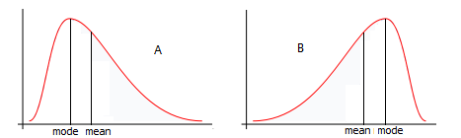
EDA – Normalizing
Right skewed
Left skewed
Normalizing these distributions is useful in statistical modelling because:
Makes data and errors Normal.
Reduces relations between Mean and variance.
Reduces the influence of outliers.
Makes multiplicative effects on a raw scale liner on the transformed scale.

Slide 35
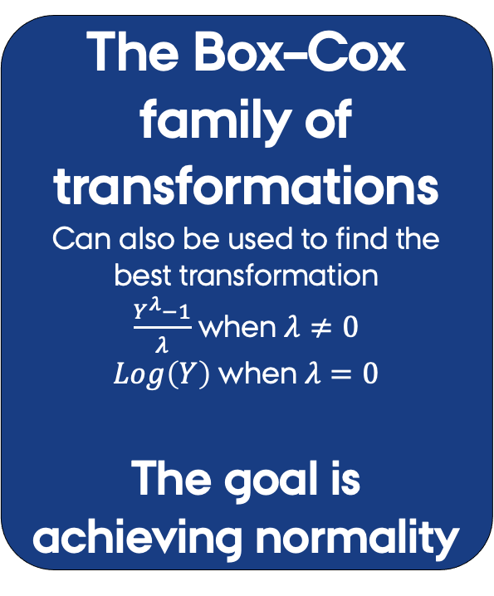
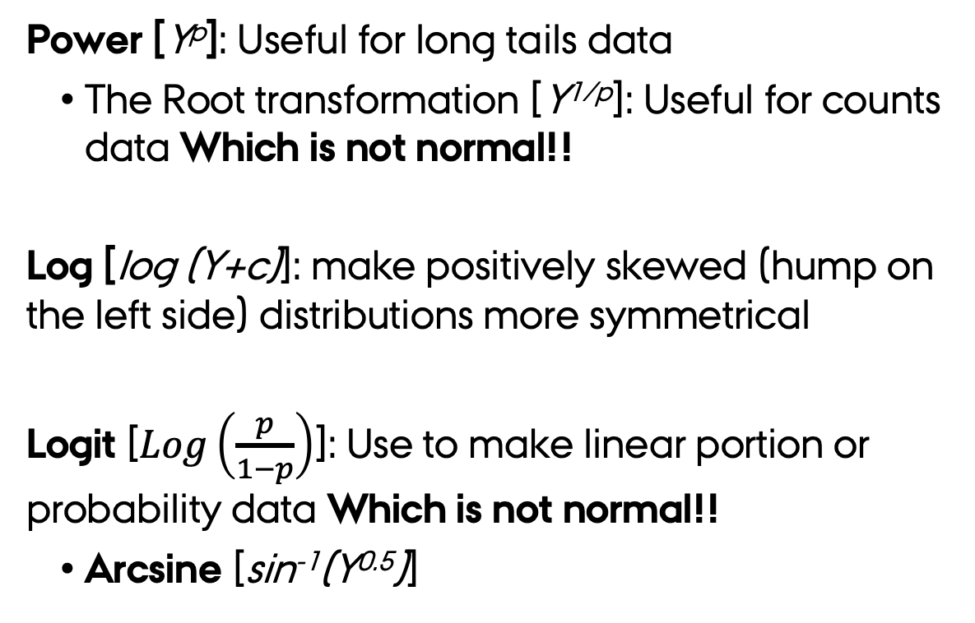
EDA – Normalizing
Power [Y^{p}]: Useful for long tails data
The Root transformation [Y^{1/p}]: Useful for counts data Which is not normal!!
Log [log (Y+c)]: make positively skewed (hump on the left side) distributions more symmetrical
Logit [$Log\left(\frac{p}{1−p}\right)$]: Use to make linear portion or probability data Which is not normal!!
Arcsine [sin⁻¹(Y^{0.5})]
The Box–Cox family of transformations
Can also be used to find the best transformation
$\frac{Y^{λ}−1}{λ}$ when $λ≠0$
$Log\left(Y\right)$ when $λ=0$
The goal is achieving normality

Slide 36
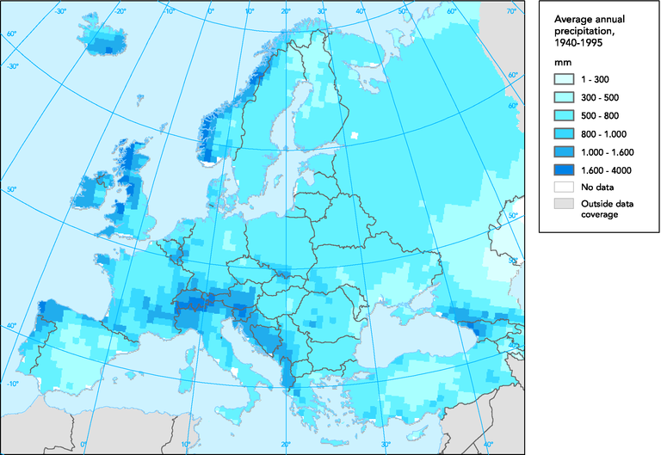
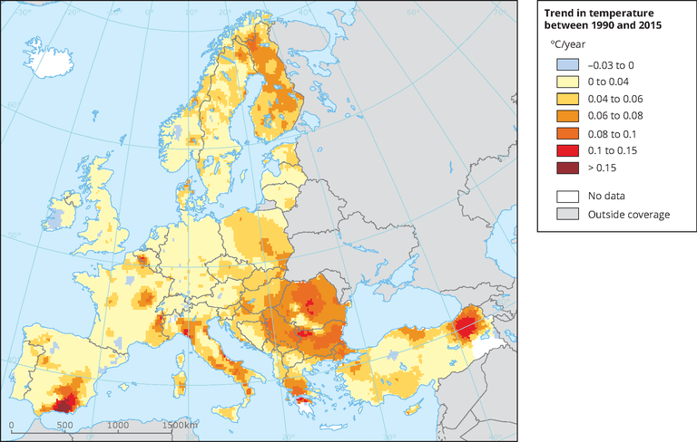
EDA – standardisations
Stabilization allows contrasting the effects of variables measured in different units in modelling frameworks

Slide 37
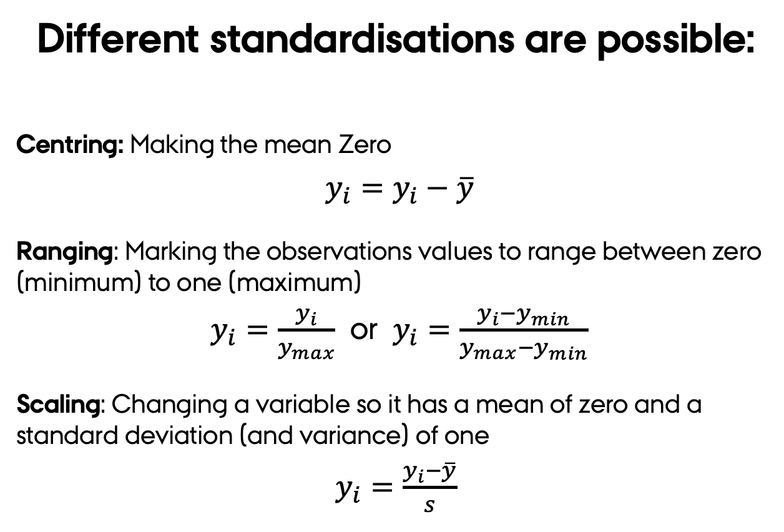
EDA – standardisations
Different standardisations are possible:
Centring: Making the mean Zero
$y_{i}=y_{i}−\overline{y}$
Ranging: Marking the observations values to range between zero (minimum) to one (maximum)
$y_{i}=\frac{y_{i}}{y_{max}}$ or $y_{i}=\frac{y_{i}−y_{min}}{y_{max}−y_{min}}$
Scaling: Changing a variable so it has a mean of zero and a standard deviation (and variance) of one
$y_{i}=\frac{y_{i}−\overline{y}}{s}$
Centring and Ranging
useful as standardisations of abundance data before multivariate analyses
Scaling
useful to convert all the variables to a similar scale

Slide 38
EDA – standardisations
Centring
Ranging
Scaling

Slide 39
Exploratory Data Analysis: tools
Descriptive
statistics
Visualisation
Transformation
Modelling
Figures: Grolemund and Wickham (2017) R for Data Science

Slide 40
EDA – Modelling
Modelling: Converting data from one format or structure into another format or structure.
Aims of Modelling before doing any analyses are:
Assess regressions assumptions (more on this next week).
Determine (in)dependence between variables → correlations
Establish additive effects if variables are dependent → linearity

Slide 41
Modelling – Correlations
Correlation coefficients is a statistical measure which determines the ‘strength’ of the co-relationship or association of two continuous variables (Y₁ and Y₂).
Correlation coefficients assume monotonic relations → always changes in the same direction
Correlation coefficients bounded between -1 and 1
y₂
Monotonically
Increasing
y₂
Monotonically
Decreasing
y₁
y₁
y₂
Non-monotonic
y₁

Slide 42
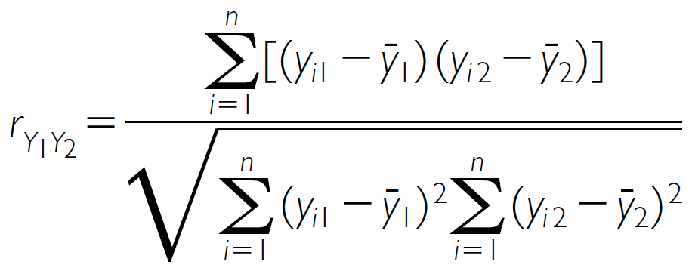
Modelling – Correlation
Parametric indices
Non-Parametric indices
Pearson correlation (r)
Spearman’s rank correlation (r_{S})
n is the number of pairs of measurements
d_{i} is the difference of the i^{th} pair of rankings
Other assumptions: normality of variables and linearity
Kendall’s rank correlation(𝜏_{A})
Correlation DOES NOT mean directionality or causality.

Slide 43
Modelling – Significance
Statistically significant means that if the Null Hypothesis (H₀) is false.
One tail test
Two tail test
H₀ Acceptance area
P=0.95
P=0.95
P=0.05
P=0.05

Slide 44
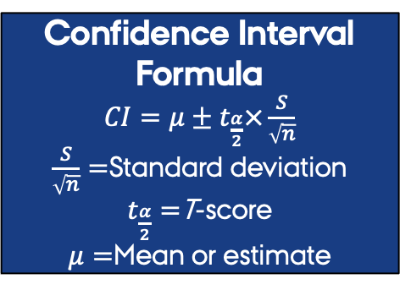
Modelling – Significance & Correlation
H₀ = Correlation estimate 95% CI includes 0
Two tail test
Estimate 95% confidence interval
The true value has a 95% change of being in this range
Confidence Interval Formula
$CI=μ±t_{\frac{α}{2}}×\frac{S}{\sqrt{n}}$
$\frac{S}{\sqrt{n}}=$Standard deviation
$t_{\frac{α}{2}}=$T-score
$μ=$Mean or estimate
Min
Lower
CI
Correlation
Mean
Upper
CI
Max
P=0.05

Slide 45
So far so good?
Any questions?
Ready to finish?

Slide 46
Summary
Exploratory Data Analysis (EDA) is the art of looking at your data
EDA is also the base for statistical analysis of multidimensional data
Before you stat you need to import and clean your data
The two crucial questions you will always ask:
What type of variation occurs within my variables?
What type of covariation occurs between my variables?

Slide 47
Summary
EDA uses four main tools:
Descriptive statistics: Quantitative descriptions or summaries of the features from a collection of information.
Visualisation: The graphical representation of information and data to see and understand trends, outliers, and patterns.
Transformation: process of changing the format, structure, or values of data
Modelling: simple low-dimensional summaries of a dataset, and trends assessments.

